Slide 1
Historic Preservation Commission
July 12, 2018

Slide 2
Member Orientation
Presentation

Slide 3
Welcome!
Introductions
Background
Interest in/experience with HPC
Meeting norms
By-laws
Agenda development
Packet
Attendance or absences (quorum)

Slide 4
Commission Bylaws
Outlines the general structure for how commissioners make motions and have discussion
Duties related to the chair and other officers
Outlines other responsibilities

Slide 5
Agenda
Pre meeting with chair one week before meetings
Packet posted online and emailed to Commissioners the Friday afternoon before Thursday meetings.
Contains staff reports or other information for items on the agenda.
Grouped by item type (presentation, action, and discussion items)

Slide 6
Structure of Meetings
Order of operations for agenda items
Chair reads item and asks if anyone needs to recuse themselves, turns item over to staff.
Staff gives a presentation, summarizing the staff report.
Commission may ask staff or the applicant questions.
Discussion amongst the Commission.
Chair will call for a motion if an action item.

Slide 7
Structure of Meetings
Items not listed on the agenda
Cannot legally be discussed.
Instead, Commissioners may ask for the item on a future meeting or for staff to provide an update.

Slide 8
Chapter 18 of the Cedar Rapids Municipal Code
Outlines the criteria for all decisions related to:
Designation of local landmarks and districts
Review and approval of COA and CNME
Review and approval of demolitions and façade modifications

Slide 9
Duties and Powers of the HPC assigned in Chapter 18
Conduct studies for identification of historic districts and sites.
Recommend listing of national or local districts or landmarks to City Council
Review and act upon all applications subject to Chapter 18
When appropriate, make recommendations to City Council on preservation issues
Educate the public on the benefits of historic preservation
When requested by the CPC or City Council, consult on changes to land use and zoning changes within local historic districts
Shall not obligate itself or the City in any financial undertaking unless authorized by City Council
Recommend acquisition or sale of historic properties and recommend preservation or restoration of city owned properties
Provide information to the City for the purpose of Historic Preservation
Promote educational programs on historic properties in the City

Slide 10
Historic Preservation Guidelines
Referred to in Chapter 18 as part of the process for reviewing COAs and CNMEs
Based on Secretary of the Interior’s Standards for the Treatment of Historic Properties (for more information, see https://www.nps.gov/tps/standards.htm)
Developed by a sub-commission of HPC—recently updated
Describes appropriate and inappropriate methods and techniques for treatment of historic properties
Used by property owners and contractors when working on historic buildings and by the Commission when deciding on approval of COA

Slide 11
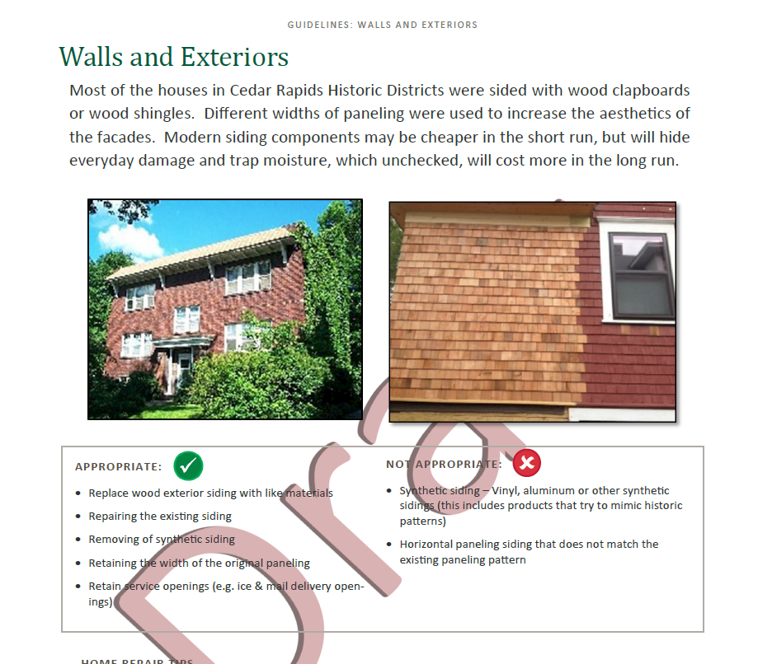

Slide 12
Chapter 18 and Design Guidelines
Chapter 18 is the Historic Preservation section of the Cedar Rapids Municipal Code—legally required to be followed
Design Guidelines are referenced in Chapter 18, but are not a regulatory document. HPC should take them into account, but the Commission has discretion in the application of the guidelines.

Slide 13
Local and National Districts and Landmarks
Local districts and landmarks have more regulations than national districts and landmarks. Review and approval is required for all exterior changes on local landmarks or properties in local districts.
HPC only reviews demolitions and façade structure modification for national landmarks and districts.

Slide 14
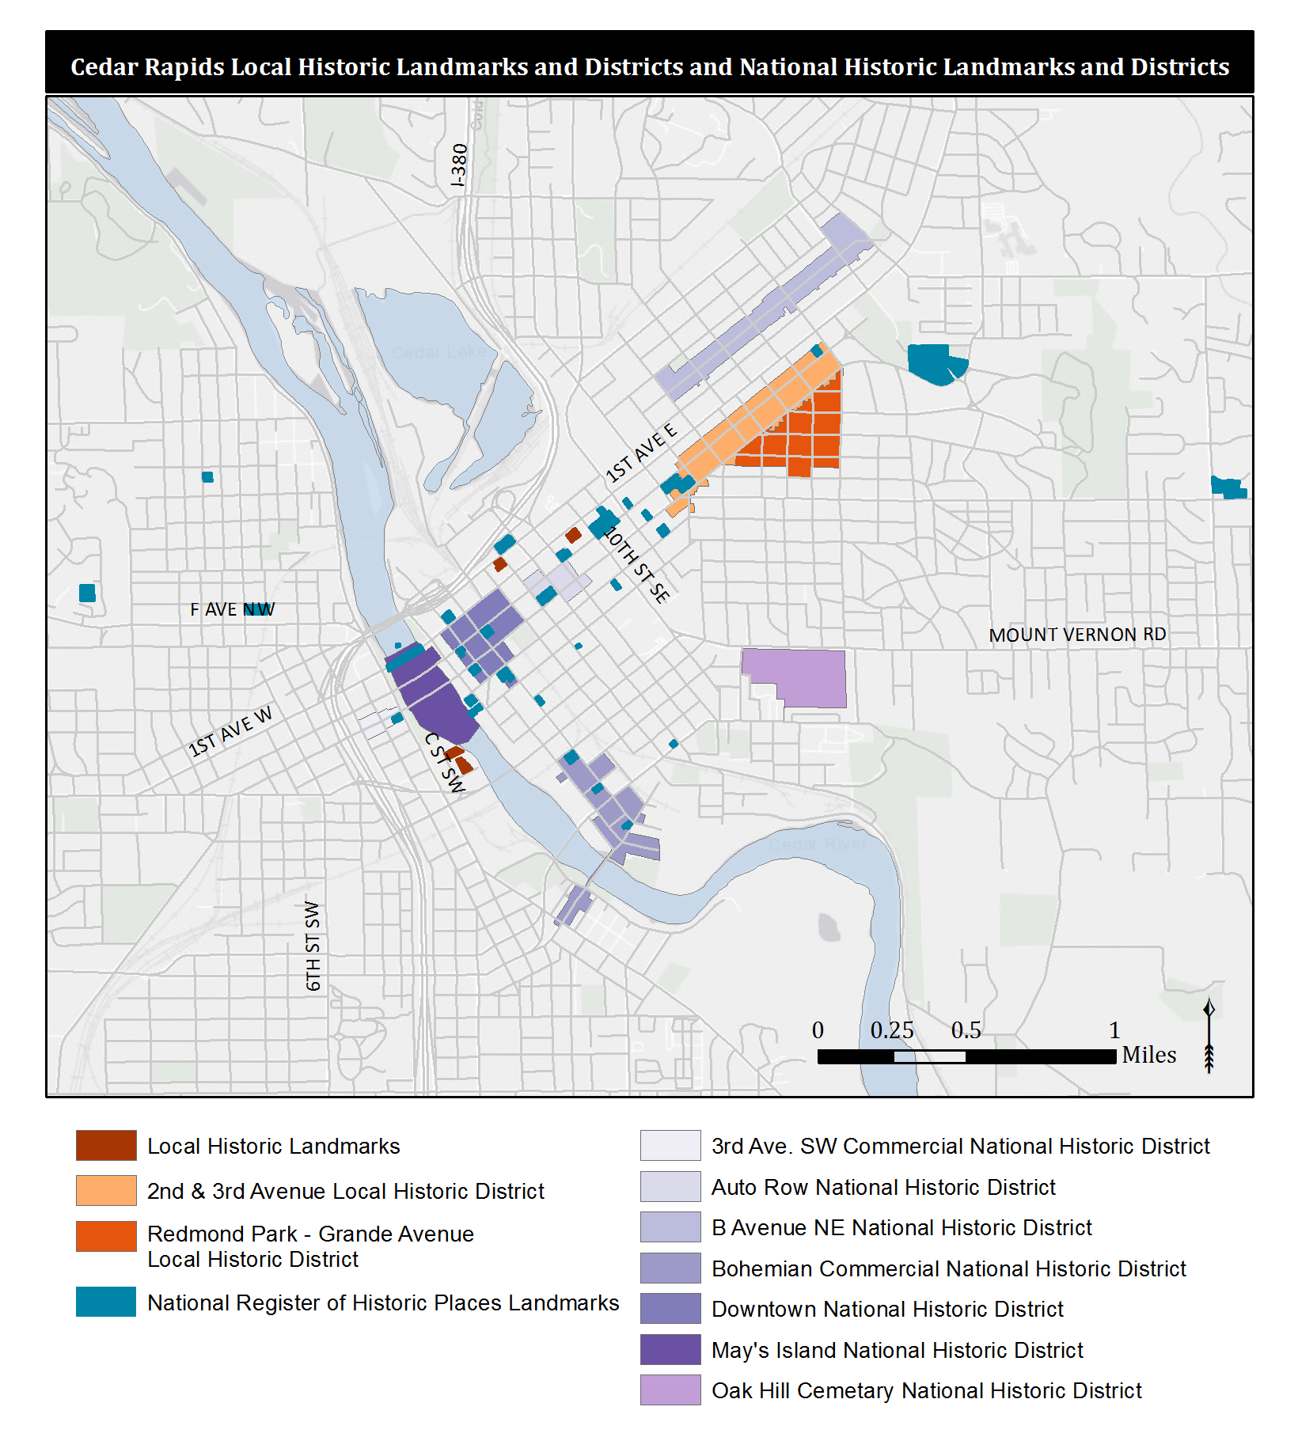
Local landmarks:
Ausadie Building, 845 1st Ave SE
Cedar Rapids Milk Condensing Company, 42 7th Ave SW
Iowa Wind Mill and Pump Company, 525 Valor Way SW
Grace Episcopal Church, 525 A Ave NE

Slide 15
Roles and Responsibilities
Commissioners
Review applications:
COA
Demolition Review
Façade modification review

Slide 16
Application for a permit
Is it a Local Landmark or in a Local District ?
Is the property any of the following:
A primary building 50 years or older?
An accessory building built in 1943 or earlier?
A National Landmark or in a National District?
No
Yes
Is the application for a façade structure modification, addition, demolition, or new construction?
No
Yes
Is the application for a demolition ?
Yes
No
No
Yes
Does it alter a defined feature? (see Site Inventory forms for defined features)
Is the property a National Landmark or in a National Historic District?
Yes
No
No
Yes
Does it meet design guidelines?
Is the application for a façade structure modification?
No
Yes
No
Yes
Certificate of Appropriateness (COA): Issued by Historic Preservation Commission
Certificate of No Material Effect (CNME): Issued by staff (1-2 days)
Is the structure or building historically significant?
No
Yes
No Review
HPC—Release
HPC—Hold up to 60 days

Slide 17
COA and CNME
A Certificate of Appropriateness (COA) must be issued for exterior changes to local landmarks or properties in local historic districts.
Some minor exterior changes may be issued a Certificate of No Material Effect (CNME) by staff, if the changes do not alter a defining feature and follow the design guidelines.
Façade structure modifications, additions, demolitions, and new constructions in local historic districts and local landmarks are not eligible for a CNME and must come before the HPC

Slide 18
COA Actions
Approve as submitted; or
Approve with modifications agreeable to the applicant; or
Deny the application; or
Request additional information.
If the commission denies a COA, the applicant may appeal to City Council, and must notify the City Clerk within 10 business days of the HPC meeting.

Slide 19
Demolition Review
HPC reviews demolition permits for the following:
Primary buildings that are 50 years old or older
Accessory buildings built in 1943 or earlier in national historic districts or landmarks, or any garage, barn, summer kitchen, or greenhouse built in 1943 or earlier
Plans for redevelopment cannot be discussed when making consideration

Slide 20
Façade Structure Modification
HPC reviews all façade structure modifications on any primary building or structure that is 50 years or older and located in a national historic district or is a national landmark
Façade structure modification definition:
“Modification to a primary building or structure which would do any of the following:
1. On a façade wall facing public street right-of-way:
a. Add floor area to the building or structure; or
b. Add another wall which encloses the original wall from view.
2. On a façade wall facing a public street right-of-way, removal of existing, above ground wall structure consisting of any of, but not limited to, the following elements: wall studs, wall framing, beams, masonry elements, and/or columns. This shall not include alterations to exterior materials such as, but not limited to: siding, wood, stucco, hardee plank, cement board, or other similar exterior wall coverings.
3. Permanent alteration to the pitch of a roof.”

Slide 21
Determining Historical Significance
Historically Significant: Any structure, building, site, property, object, or item which is determined by the Cedar Rapids Historic Preservation Commission, National Park Service or State of Iowa Historic Preservation Office to possess integrity and meet one or more of the following:
Associated with events that have made a significant contribution to the broad patterns of our history; or
Associated with the lives of significant persons in our past; or
Embodies the distinctive characteristics of a type, period, or method of construction, or represents the work of a master, or possesses high artistic values, or represents a significant and distinguishable entity whose components may lack individual distinction; or
Yielded, or may be likely to yield, information important in history or prehistory.

Slide 22
Determining Historical Significance
City surveys
Reconnaissance Level Survey
Intensive Level Survey
http://www.cedar-rapids.org/local_government/departments_a_-_f/community_development/historic_surveys_and_data/index.php
Access completed surveys
http://crgis.cedar-rapids.org/HDV/index.html
GIS Map showing historic districts and survey information
For properties that have not been surveyed, the City relies on the guidance and expertise of the Commission to determine historical significance

Slide 23
Demolition and Façade Structure Modification Review Actions
1. Determination of Historic Significance
2a. Not Historically Significant
2b. Historically Significant
Release Property
60-day hold if HPC wishes to explore options (e.g. photo doc) with property owner
Release property if HPC does not wish to explore options
“If the HPC places a hold, the HPC shall indicate which criteria per Section 18.02.T makes the building or structure historically significant as part of the permanent minute record of the HPC” (Chapter 18, Section 18.09.D.4)

Slide 24
During the 60 day hold, the Historic Preservation Commission shall work with the property owner to explore the following alternatives to determine if any are feasible:
Designation as a local historic landmark.
Rehabilitation utilizing State or Federal tax incentives.
Adaptation of the building or structure to a new use or incorporating the building or structure into redevelopment plans.
Finding a new owner who is interested in preserving or rehabilitating the building or structure.
Looking for an alternative location for the redevelopment proposal.
Moving the building or structure to an alternative location if proposed for demolition.
Salvaging building materials.
Additional documentation of the exterior of the building or structure prior to the issuance of a building permit.

Slide 25
Historic Rehab Program
Established in August 2016 to replace Paint Rebate Program
Eligible projects include:
Historic window repair
Wood door refinishing
Painting wood or stucco exteriors
Front porch repair
Chimney repair
Limited to local historic districts and local landmarks

Slide 26
Historic Rehab Program
Grant or loan for 50% of project of up to $5,000
Applicants submit plans and at least two reasonable bids
Staff will review application and submit to HPC for approval
Approved funding:
FY17 - $47,500 (11 projects total)
FY18 - $11,980 (4 projects total)

Slide 27
General Responsibilities
Commissioners
Arrive with a general understanding of the agenda items.
Be ready to ask any questions and discuss thoughts on topics on the agenda.
Suggest ideas and add to the discussion on agenda items.
Volunteer for subcommittees and other projects as they arise.
Suggest ideas for future HPC discussion items.

Slide 28
Roles and Responsibilities
City Staff
Prepare meeting agendas, packets, other documents.
Reserve meeting space, schedule meetings, any necessary notices and mailings.
Contacting applicants and obtain answers to questions from the HPC

Slide 29
Roles and Responsibilities
City Staff
Answer technical questions raised by the HPC.
Coordinate agenda items with other City Departments and outside agencies.
Issue Certificates of No Material Effect (CNME)

Slide 30
Historic Preservation Plan, 2015
Vision for Preservation in Cedar Rapids
Goals, policies, and initiatives
Implementation plan
Historic Preservation administration
List of identified and potential resources
Incentives and benefits
Educational resources
Information on Cedar Rapids history
http://www.cedar-rapids.org/local_government/departments_a_-_f/community_development/plans/index.php

Slide 31
2018 Work Plan
Goal 1: Participate in preservation, salvage and documentation of historic structures
Goal 2: Increase communication
Goal 3: Improve public relations
Goal 4: Provide information and educational opportunities for the public
Goal 5: Provide educational opportunities for HPC members
More information on specific tasks will be provided at the July 26 meeting

Slide 32
National Park Service
Organization which provides guidance and administers preservation at the Federal Government level.
National Register of Historic Places
https://www.nps.gov/nr/
Secretary of the Interior’s Standards
https://www.nps.gov/tps/standards.htm

Slide 33
State Historic Preservation Office (SHPO)
Organization which administers preservation at the State Government level.
Administer the Certified Local Government (CLG) program.
Review documents and other materials for both public agencies and private entities.
https://iowaculture.gov/history/preservation

Slide 34
Section 106 Review
Required for all Federal undertakings as part of the National Historic Preservation Act of 1966.
Determination and coordination of review is the responsibility of the Federal agency.
Federal agency works with SHPO to identify historic properties and prevent or mitigate adverse effects
Wireless communications facilities (FCC)
Road projects using federal dollars

Slide 35
Historic Preservation Postcards
Presentation

Slide 36
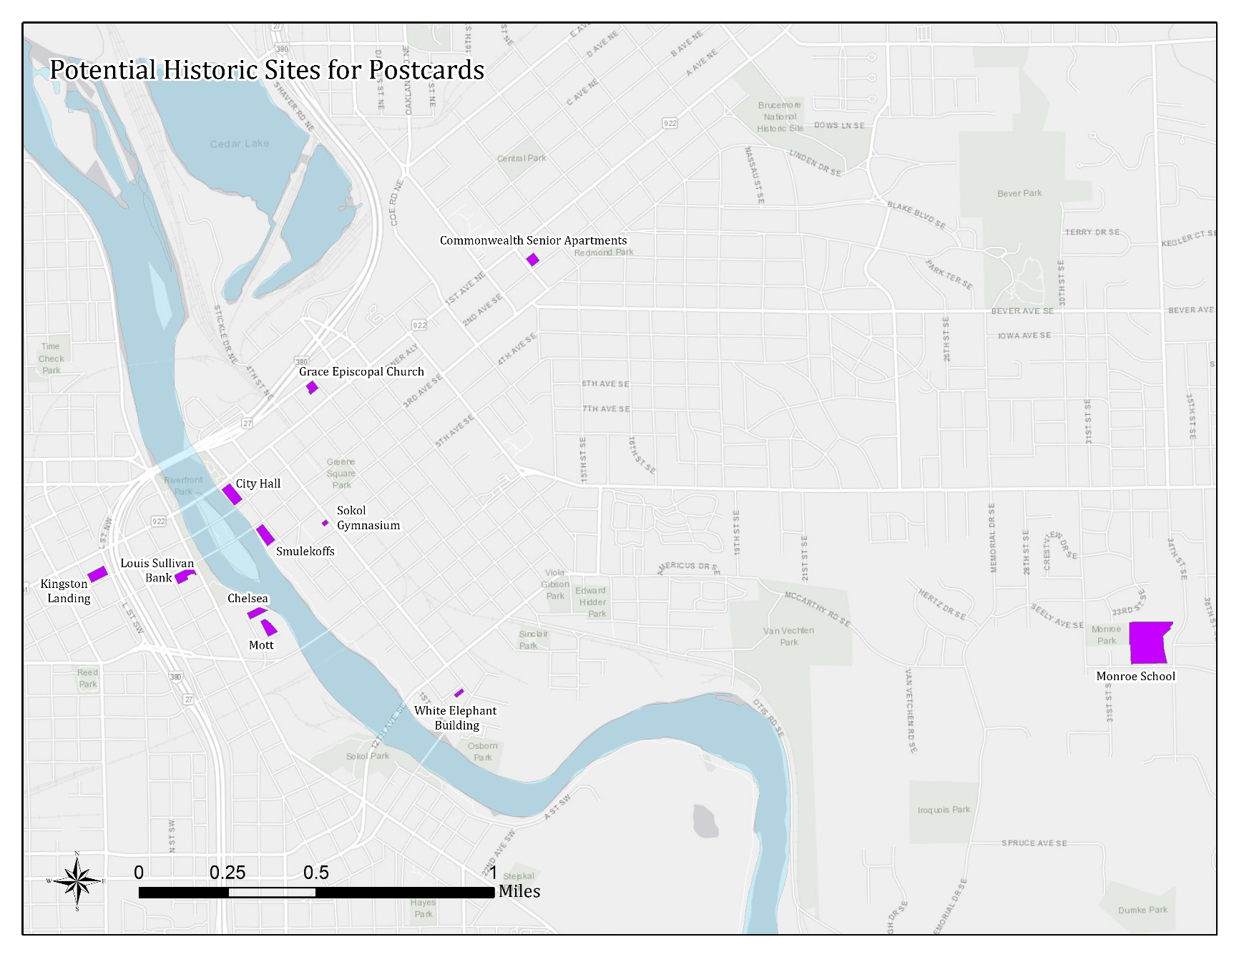
Preliminary List of Properties
The Chelsea
The Mott
Commonwealth Senior Apartments
Smulekoffs
Grace Episcopal Church
City Hall
White Elephant Building
Louis Sullivan Bank
Sokol Gymnasium
Kingston Landing
Monroe School

Slide 37
Design Guidelines
Action Item

Slide 38
Design Guidelines
Updates:
Added missing content
Clarification on review process for non-historic materials
Updated glossary to include missing terms
Added hyperlinks to webpages and glossary terms
All changes since the previous version are in green text in the document.

Slide 39
347 18th Street SE
Certificate of Appropriateness

Slide 40
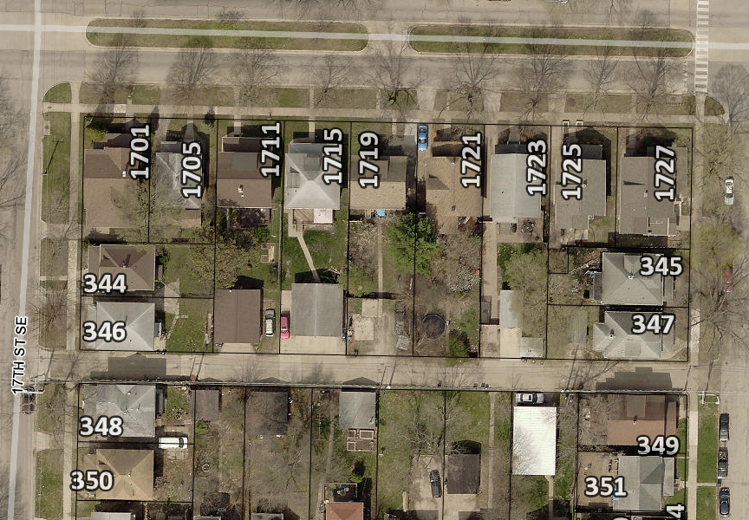
Project Description
Removing wood railing on covered front porch and porch skirting and replacing with wood materials
Primary structure built in 1915
Contributing structure to the Redmond Park—Grande Avenue Historic District

Slide 41
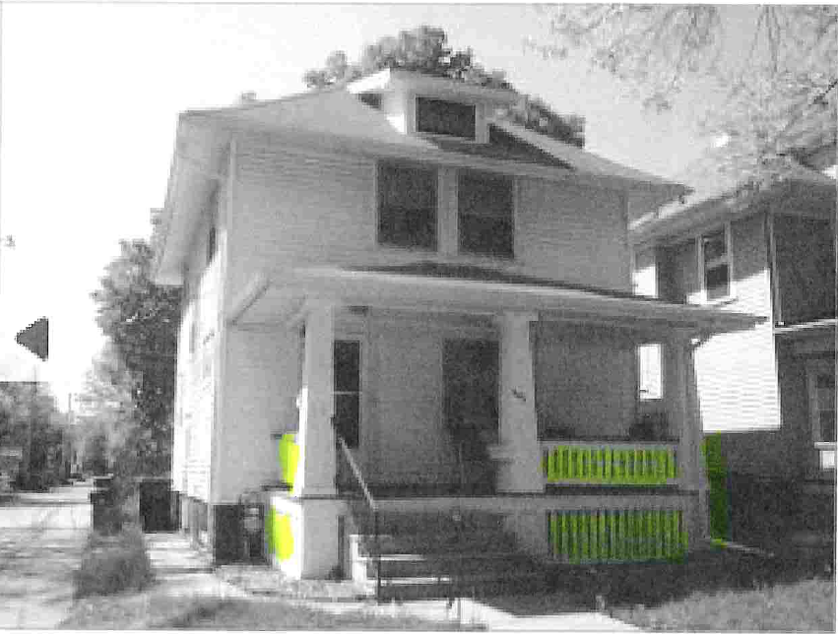
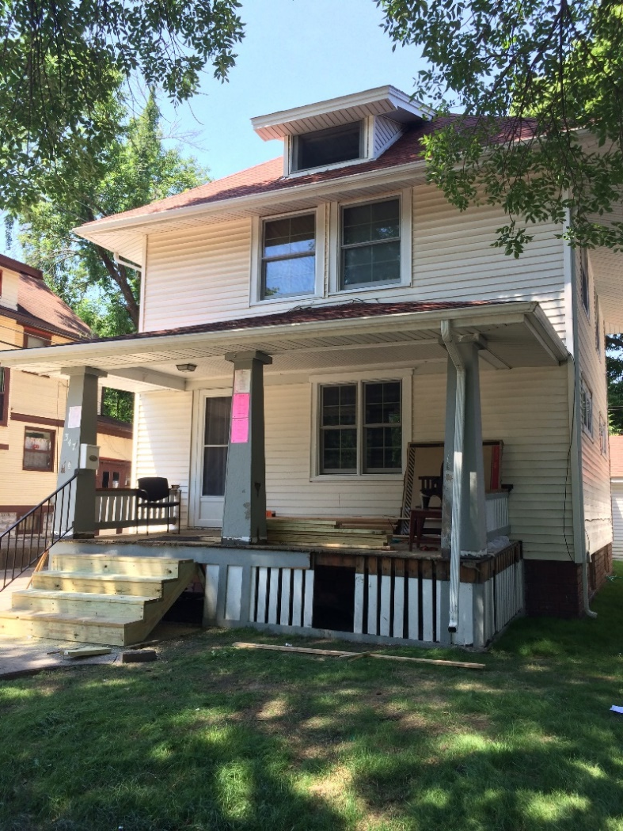
347 18th St SE

Slide 42
Historic District Guidelines – Porches and Other Entrances
Recommended:
Opening an enclosed porch
Repairing the existing porch or balcony
Replacing wood elements with wood elements (wood elements should be painted)
Replacing masonry elements with masonry elements
Rebuilding a porch with original materials
Screening
Painted, not treated wood
Not Recommended:
Enclosing porches visible from street
Modern straight-edged railings
Columns made of modern materials (fiberglass for an example)
Plywood panel flooring on entrances facing the street
Carpeted flooring on entrances facing the street
Concrete steps that are visible from the street
Unpainted treated lumber elements (recommended for hidden supports)

Slide 43
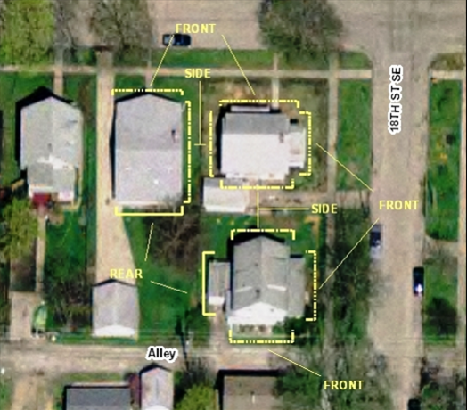
Guideline Prioritization
Those features that face the street or face the alley where it intersects the street. Buildings on corner lots, lots which are located at the intersection of two streets, or at the intersection of a street and an alley, are considered to have two street faces.
Features on sides of buildings that are visible from the street but don’t directly face the street.
Other exterior features not in direct view from the street such as at the rear of buildings.

Slide 44
Criteria for Decision
If any defining features of the building or structure as indicated, but not limited to those included on the Site Inventory Form(s) are proposed to be modified as a result of the proposal indicated on the application for Certificate.
If the proposal is consistent with the Guidelines for Cedar Rapids Historic Districts and/or the most recent edition of the Secretary of Interior's Standards for Rehabilitating Historic Buildings.
If the proposal mitigates adverse effects on the aesthetic, historic, or architectural significance of either the building or structure or of the local historic district or local historic landmark.

Slide 45
Recommendation
Staff recommends approval of project
Applicant intends to replace the wooden porch railing and skirt with like wood materials

Slide 46
Actions
Approve as submitted; or
Approve with modifications agreeable to the applicant; or
Deny the application; or
Request additional information.

Slide 47
1124 1st Street NW
Demolition Review

Slide 48
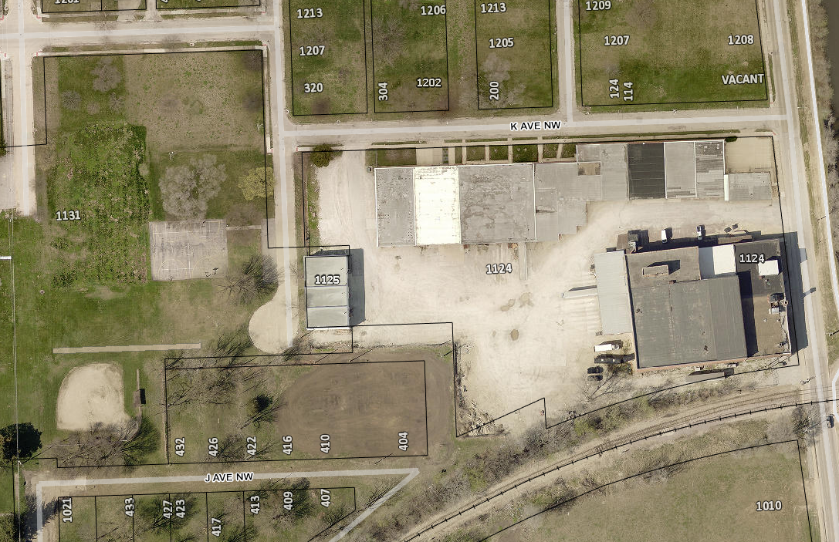
Project Description
Primary structures built in 1940, 1950, and 1965
Identified as ineligible for individual listing or listing as part of a historic district
Architectural Reconnaissance Survey for Hull’s 3rd Addition to Cedar Rapids
Immediate Release
Does not include NE building

Slide 49
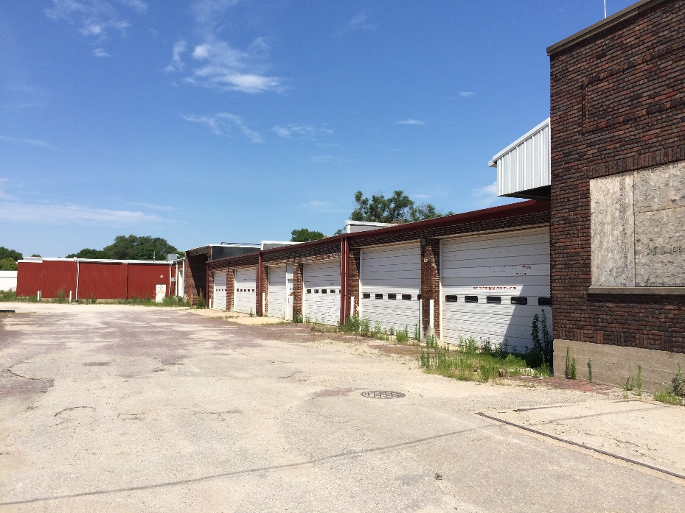
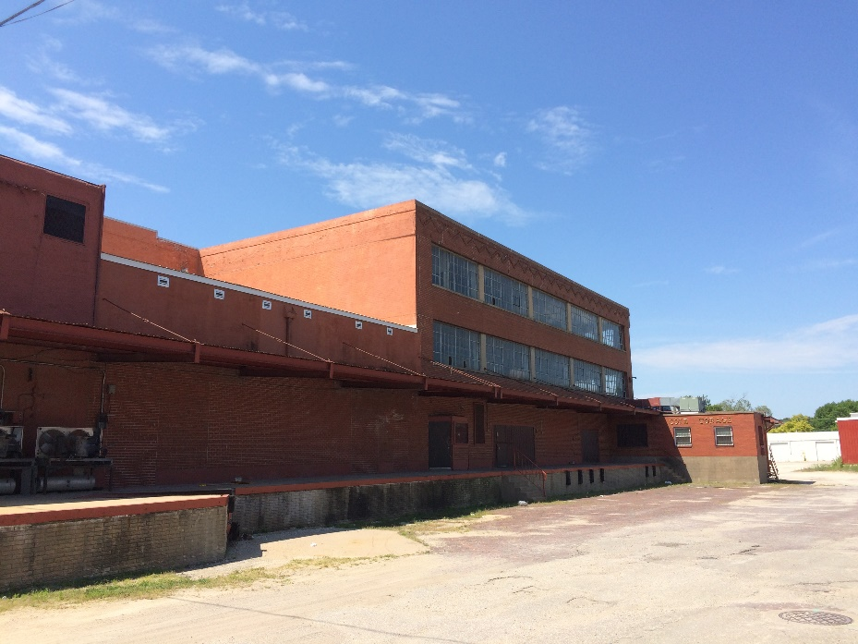
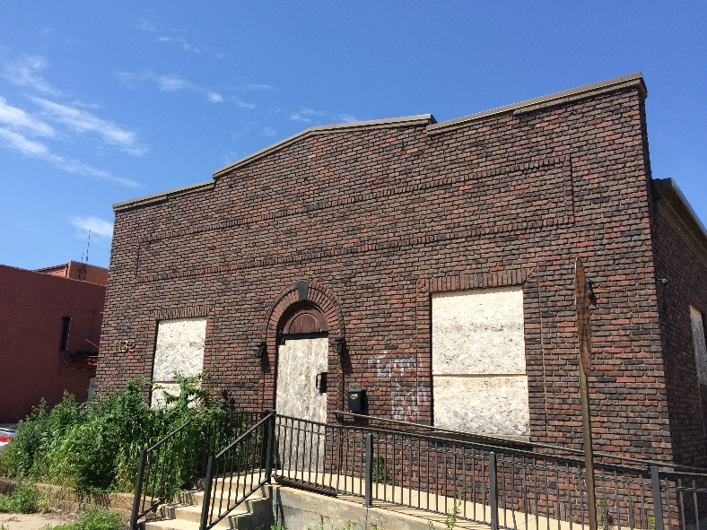
1124 1st St NW

Slide 50
1124 1st St NW
Poor candidate for landmarking
Survey indicates the structures are not eligible resources
Property will be used for flood control system

Slide 51
1. Determination of Historic Significance
2a. Not Historically Significant
2b. Historically Significant
Release Property
60-day hold if HPC wishes to explore options (e.g. photo doc) with property owner
Release property if HPC does not wish to explore options

Slide 52
18.02(T) Cedar Rapids Municipal Code – Historic Significance:
1. Associated with events that have made a significant contribution to the broad patterns of our history; or
2. Associated with the lives of significant persons in our past; or
3. Embodies the distinctive characteristics of a type, period, or method of construction, or represents the work of a master, or possesses high artistic values, or represents a significant and distinguishable entity whose components may lack individual distinction; or
4. Yielded, or may be likely to yield, information important in history or prehistory.

Slide 53
1901 Mt. Vernon Road SE
Demolition Review

Slide 54
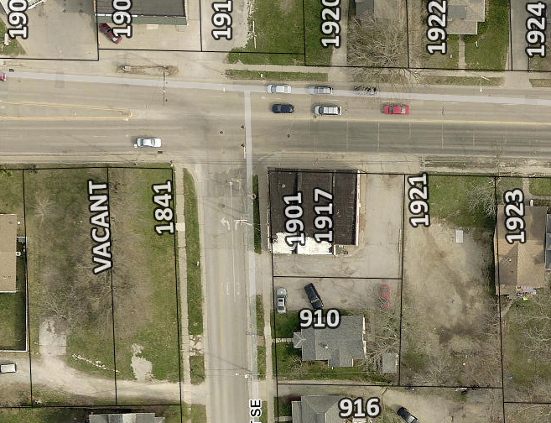
Project Description
Primary structure built in 1915
Not included in a survey area or recommended for survey
Condition is normal, per city assessor

Slide 55
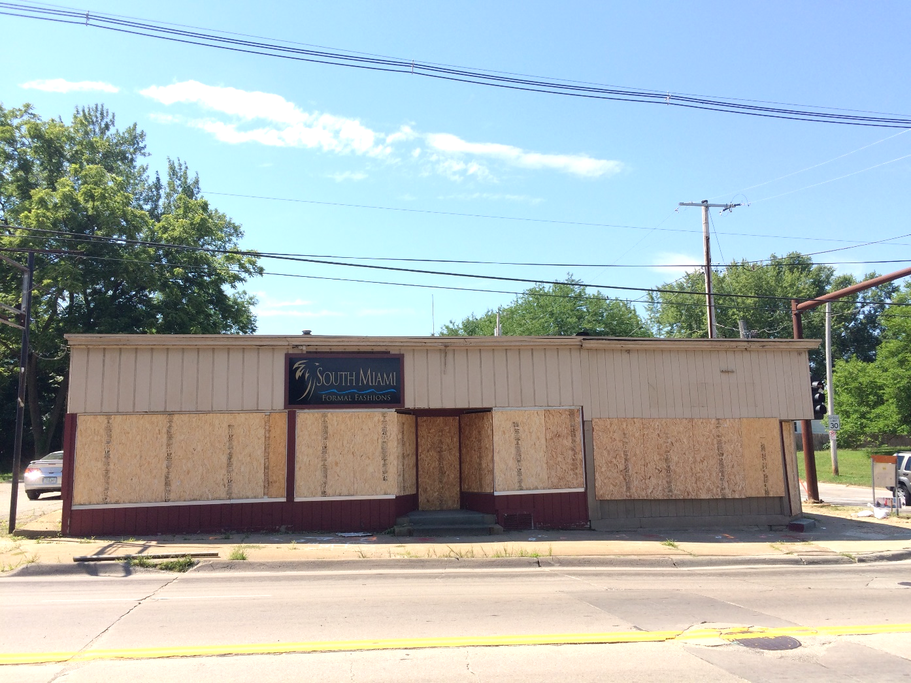
1901 Mt. Vernon Rd SE

Slide 56
1901 Mt. Vernon Rd SE
Poor candidate for local landmarking or inclusion in a historic district
No evidence to corroborate historical significance
Property will be used for Paving for Progress project

Slide 57
1. Determination of Historic Significance
2a. Not Historically Significant
2b. Historically Significant
Release Property
60-day hold if HPC wishes to explore options (e.g. photo doc) with property owner
Release property if HPC does not wish to explore options

Slide 58
18.02(T) Cedar Rapids Municipal Code – Historic Significance:
1. Associated with events that have made a significant contribution to the broad patterns of our history; or
2. Associated with the lives of significant persons in our past; or
3. Embodies the distinctive characteristics of a type, period, or method of construction, or represents the work of a master, or possesses high artistic values, or represents a significant and distinguishable entity whose components may lack individual distinction; or
4. Yielded, or may be likely to yield, information important in history or prehistory.

Slide 59
1138 19th Street SE
Demolition Review

Slide 60
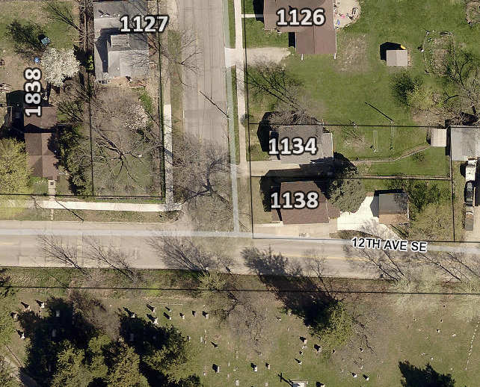
Project Description
Primary structure built in 1934
Identified as ineligible for landmarking or inclusion in a historic district
2006 Architectural Survey and Update for the City of Cedar Rapids
Condition is above normal, per city assessor

Slide 61
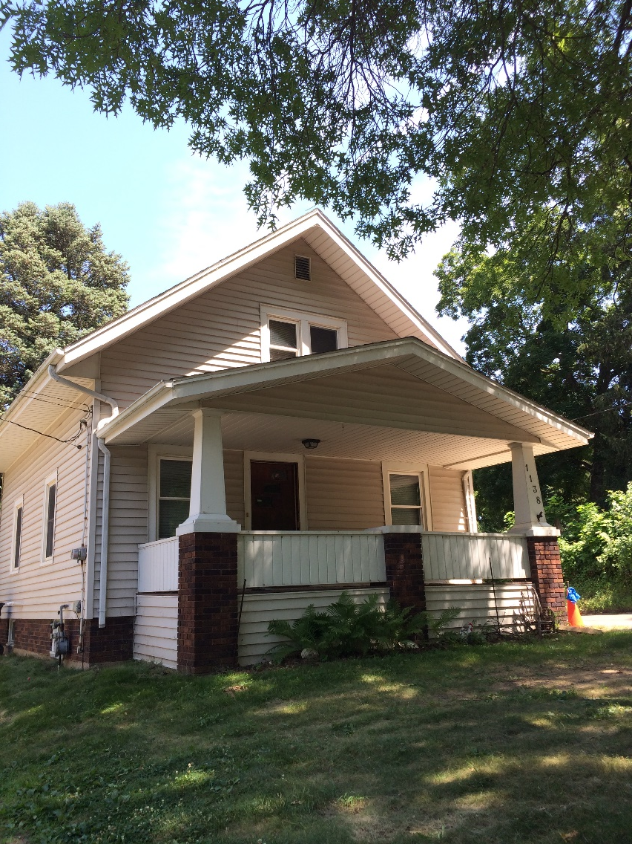
1138 19th St. SE

Slide 62
1138 19th St SE
Poor candidate for local landmarking
Survey indicates structure is not an eligible resource
Property will be used for Paving for Progress.

Slide 63
1. Determination of Historic Significance
2a. Not Historically Significant
2b. Historically Significant
Release Property
60-day hold if HPC wishes to explore options (e.g. photo doc) with property owner
Release property if HPC does not wish to explore options

Slide 64
18.02(T) Cedar Rapids Municipal Code – Historic Significance:
1. Associated with events that have made a significant contribution to the broad patterns of our history; or
2. Associated with the lives of significant persons in our past; or
3. Embodies the distinctive characteristics of a type, period, or method of construction, or represents the work of a master, or possesses high artistic values, or represents a significant and distinguishable entity whose components may lack individual distinction; or
4. Yielded, or may be likely to yield, information important in history or prehistory.

Slide 65
590 Penn Avenue NW
Demolition Review

Slide 66
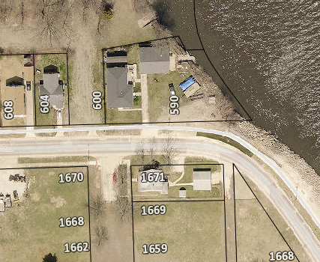
Project Description
Primary structure built in 1957
Identified as ineligible for landmarking or inclusion in a historic district
Architectural Reconnaissance Survey for Hull’s 6th Addition, 2009
Condition is very good, per city assessor

Slide 67
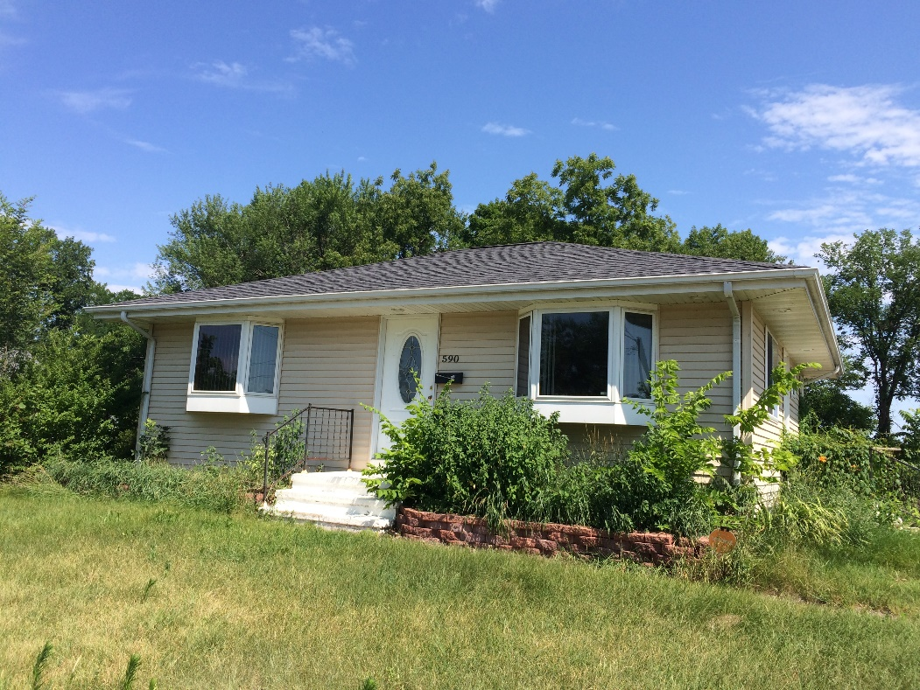
590 Penn Ave NW

Slide 68
590 Penn Ave NW
Poor candidate for local landmarking
Identified in survey as not an eligible resource
Property will be used for the Flood Control System

Slide 69
1. Determination of Historic Significance
2a. Not Historically Significant
2b. Historically Significant
Release Property
60-day hold if HPC wishes to explore options (e.g. photo doc) with property owner
Release property if HPC does not wish to explore options

Slide 70
18.02(T) Cedar Rapids Municipal Code – Historic Significance:
1. Associated with events that have made a significant contribution to the broad patterns of our history; or
2. Associated with the lives of significant persons in our past; or
3. Embodies the distinctive characteristics of a type, period, or method of construction, or represents the work of a master, or possesses high artistic values, or represents a significant and distinguishable entity whose components may lack individual distinction; or
4. Yielded, or may be likely to yield, information important in history or prehistory.

Slide 71
1311 3rd Street NW
Demolition Review

Slide 72
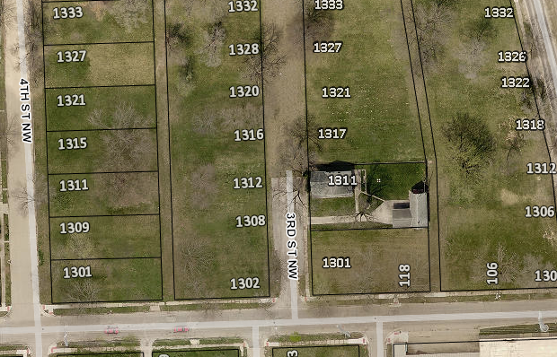
Project Description
Primary structure built in 1890
Ineligible for individual listing or inclusion in a historic district
Architectural Reconnaissance Survey for Hull’s 6th Addition, 2009
Damaged in 2008 flood

Slide 73
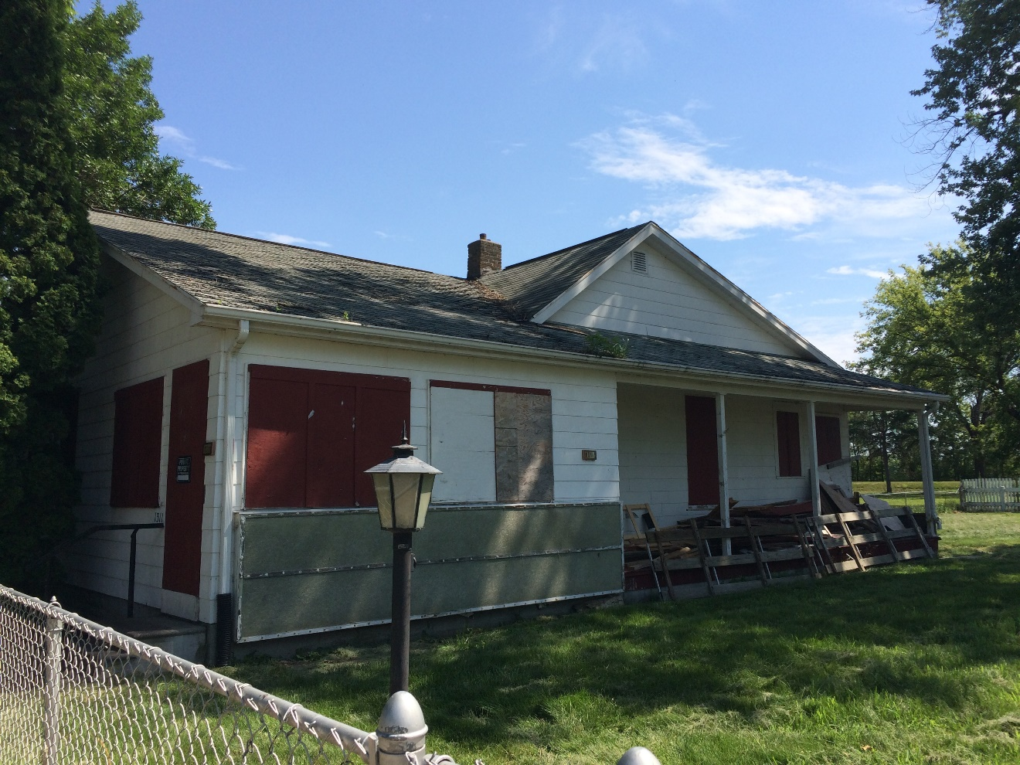
1311 3rd St NW

Slide 74
1311 3rd St NW
Poor candidate for local landmarking or inclusion in a historic district
Survey identified as not an eligible resource
Property will be used for the Flood Control System

Slide 75
1. Determination of Historic Significance
2a. Not Historically Significant
2b. Historically Significant
Release Property
60-day hold if HPC wishes to explore options (e.g. photo doc) with property owner
Release property if HPC does not wish to explore options

Slide 76
18.02(T) Cedar Rapids Municipal Code – Historic Significance:
1. Associated with events that have made a significant contribution to the broad patterns of our history; or
2. Associated with the lives of significant persons in our past; or
3. Embodies the distinctive characteristics of a type, period, or method of construction, or represents the work of a master, or possesses high artistic values, or represents a significant and distinguishable entity whose components may lack individual distinction; or
4. Yielded, or may be likely to yield, information important in history or prehistory.

Slide 77
1208 39th Street Road NW
Demolition Review

Slide 78
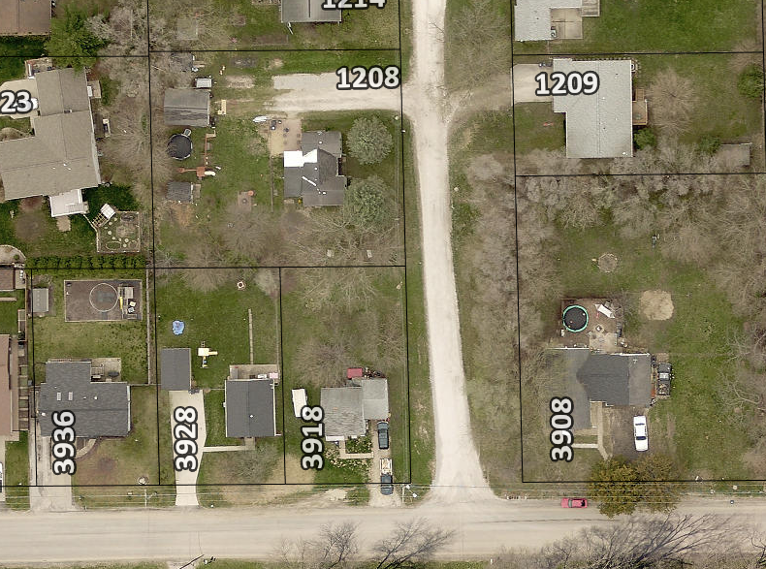
Project Description
Primary structure built in 1952
Not included in a survey area or recommended for survey
Condition is poor, per city assessor

Slide 79
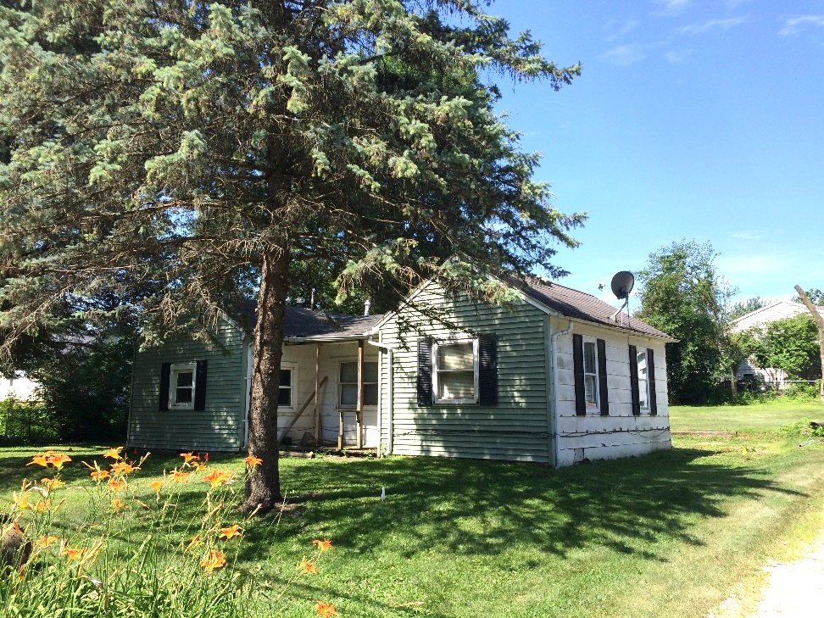
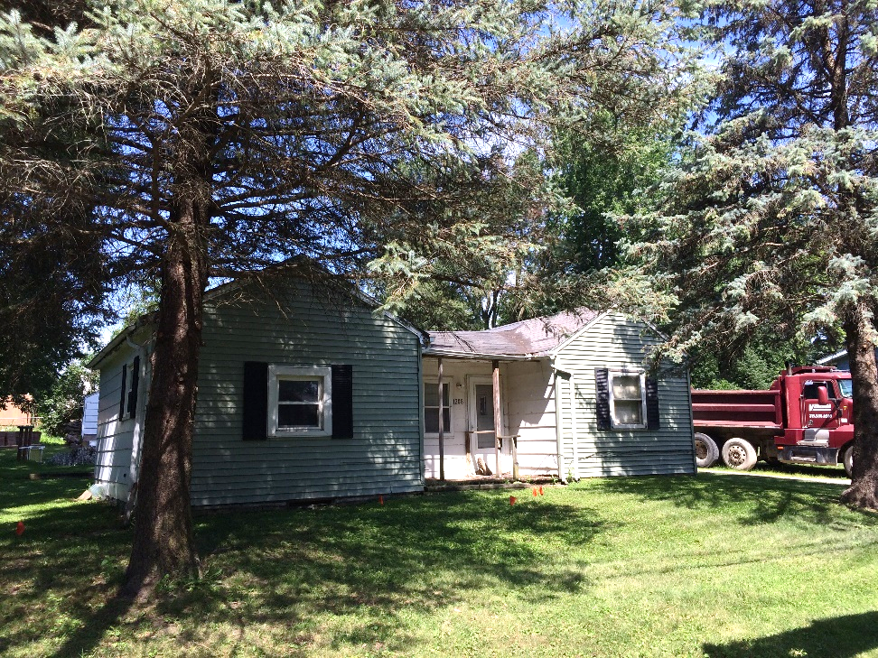
1208 39th St Rd NW

Slide 80
1. Determination of Historic Significance
2a. Not Historically Significant
2b. Historically Significant
Release Property
60-day hold if HPC wishes to explore options (e.g. photo doc) with property owner
Release property if HPC does not wish to explore options

Slide 81
18.02(T) Cedar Rapids Municipal Code – Historic Significance:
1. Associated with events that have made a significant contribution to the broad patterns of our history; or
2. Associated with the lives of significant persons in our past; or
3. Embodies the distinctive characteristics of a type, period, or method of construction, or represents the work of a master, or possesses high artistic values, or represents a significant and distinguishable entity whose components may lack individual distinction; or
4. Yielded, or may be likely to yield, information important in history or prehistory.

Slide 82
Historic Preservation Commission
Staff Liaison:
Adam Lindenlaub
Comm. Dev. Planner
a.lindenlaub@cedar-rapids.org
319.286.5064
William Micheel
Comm. Dev. Assistant Director
w.micheel@cedar-rapids.org
319.286.5045

