Slide 1
Historic Preservation Commission
June 14, 2018

Slide 2
Role of HPC related to CRCSD Infrastructure Plans
Presentation

Slide 3
1000 M Ave NW
Demolition Review

Slide 4
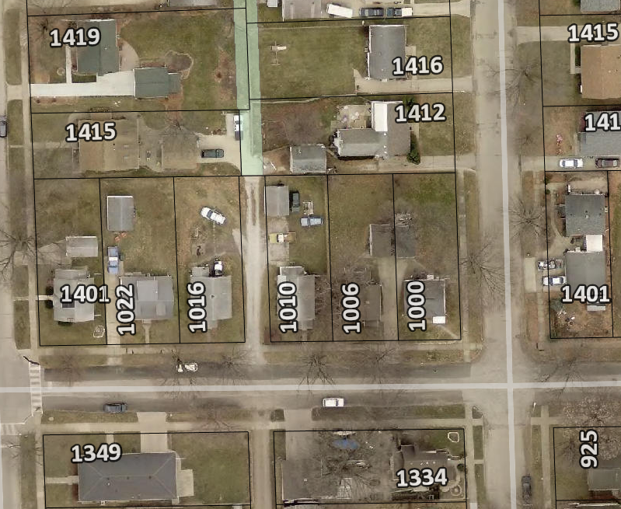
1000 M Ave NW
Accessory structure built in 1920
Within Wagner’s Area Intensive Survey
Immediate Release

Slide 5
1000 M Ave NW

Slide 6
1000 M Ave NW

Slide 7
1000 M Ave NW
Accessory structure not mentioned individually in the survey
The style and character is not consistent with known historical carriage houses in the City.

Slide 8
1. Determination of Historic Significance
2a. Not Historically Significant
2b. Historically Significant
Release Property
60-day hold if HPC wishes to explore options (e.g. photo doc) with property owner
Release property if HPC does not wish to explore options

Slide 9
18.02(T) Cedar Rapids Municipal Code – Historic Significance:
1. Associated with events that have made a significant contribution to the broad patterns of our history; or
2. Associated with the lives of significant persons in our past; or
3. Embodies the distinctive characteristics of a type, period, or method of construction, or represents the work of a master, or possesses high artistic values, or represents a significant and distinguishable entity whose components may lack individual distinction; or
4. Yielded, or may be likely to yield, information important in history or prehistory.

Slide 10
3610 Crestwood Dr NW
Demolition Review

Slide 11
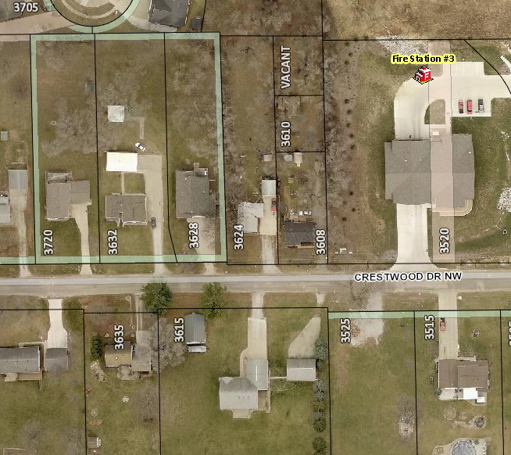
3610 Crestwood Dr NW
Structure built in 1941
Property not recommended for area of intensive study
Cedar Rapids Citywide Historic and Architectural Reconnaissance Survey
Immediate release

Slide 12
3610 Crestwood Dr NW

Slide 13
3610 Crestwood Dr NW
Poor candidate for local landmarking
Not within recommended area for intensive survey
No historical data to corroborate historical significance

Slide 14
1. Determination of Historic Significance
2a. Not Historically Significant
2b. Historically Significant
Release Property
60-day hold if HPC wishes to explore options (e.g. photo doc) with property owner
Release property if HPC does not wish to explore options

Slide 15
18.02(T) Cedar Rapids Municipal Code – Historic Significance:
1. Associated with events that have made a significant contribution to the broad patterns of our history; or
2. Associated with the lives of significant persons in our past; or
3. Embodies the distinctive characteristics of a type, period, or method of construction, or represents the work of a master, or possesses high artistic values, or represents a significant and distinguishable entity whose components may lack individual distinction; or
4. Yielded, or may be likely to yield, information important in history or prehistory.

Slide 16
416 4th Ave SW
Demolition Review

Slide 17
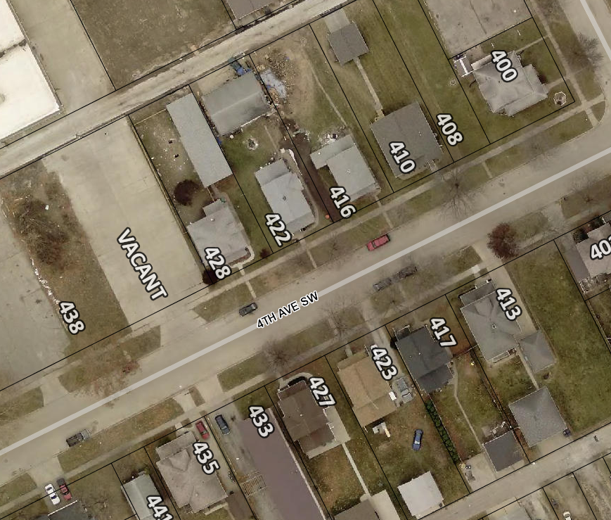
416 4th Ave SW
Structure built in 1900
Identified as ineligible for National Register listing
Young’s Hill/Kingston Neighborhood Historical and Architectural Survey Report, 2008
Immediate release

Slide 18
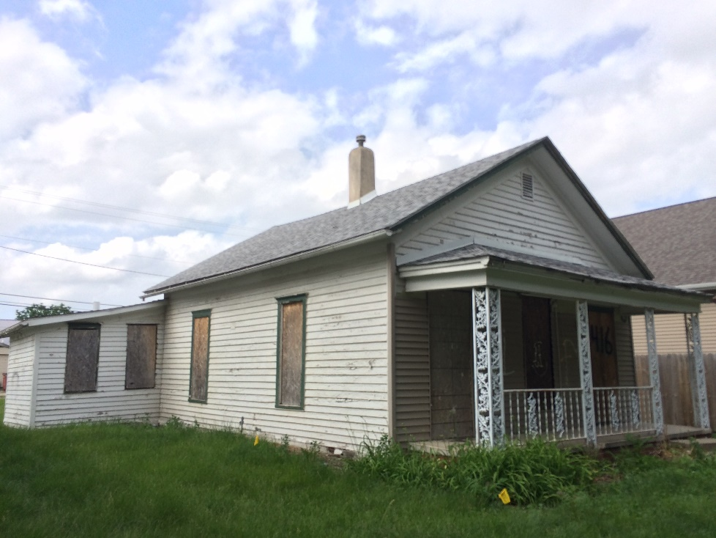
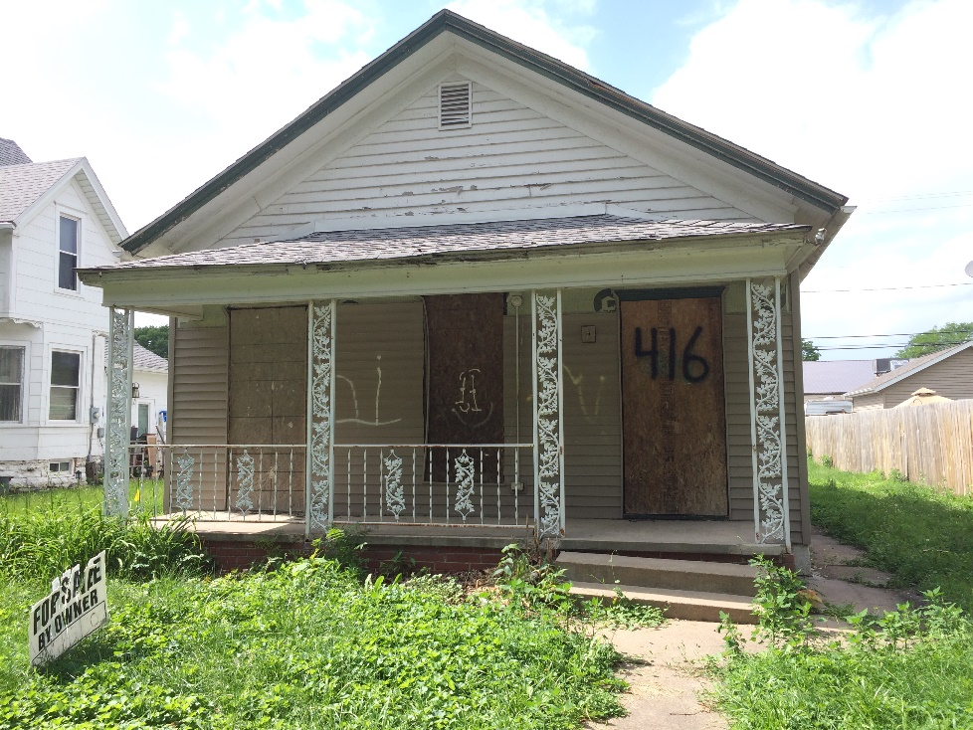
416 4th Ave SW

Slide 19
416 4th Ave SW
Poor candidate for local landmarking
Condition is below normal per City assessor
No historical data to corroborate historical significance

Slide 20
1. Determination of Historic Significance
2a. Not Historically Significant
2b. Historically Significant
Release Property
60-day hold if HPC wishes to explore options (e.g. photo doc) with property owner
Release property if HPC does not wish to explore options

Slide 21
18.02(T) Cedar Rapids Municipal Code – Historic Significance:
1. Associated with events that have made a significant contribution to the broad patterns of our history; or
2. Associated with the lives of significant persons in our past; or
3. Embodies the distinctive characteristics of a type, period, or method of construction, or represents the work of a master, or possesses high artistic values, or represents a significant and distinguishable entity whose components may lack individual distinction; or
4. Yielded, or may be likely to yield, information important in history or prehistory.

Slide 22
1029 3rd Street SE
Façade Structure Modification Review

Slide 23
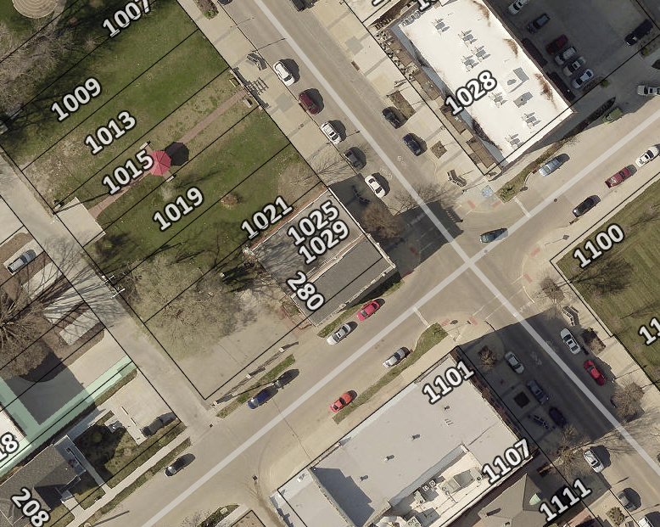
Project Description
Single-story commercial building built in 1893
Addition of 530 square foot valet lobby in the rear of the building
Located in the Bohemian Commercial National Historic District

Slide 24
1029 3rd Street SE

Slide 25
1029 3rd Street SE
SHPO review has concluded that the building is not a contributing structure to the Bohemian Commercial National Historic District
Immediate Release

Slide 26
1. Determination of Historic Significance
2a. Not Historically Significant
2b. Historically Significant
Release Property
60-day hold if HPC wishes to explore options (e.g. photo doc) with property owner
Release property if HPC does not wish to explore options

Slide 27
18.02(T) Cedar Rapids Municipal Code – Historic Significance:
Associated with events that have made a significant contribution to the broad patterns of our history; or
Associated with the lives of significant persons in our past; or
Embodies the distinctive characteristics of a type, period, or method of construction, or represents the work of a master, or possesses high artistic values, or represents a significant and distinguishable entity whose components may lack individual distinction; or
Yielded, or may be likely to yield, information important in history or prehistory.

Slide 28
1627 Park Ave SE
Historic Rehab Program—Consideration of Funding

Slide 29
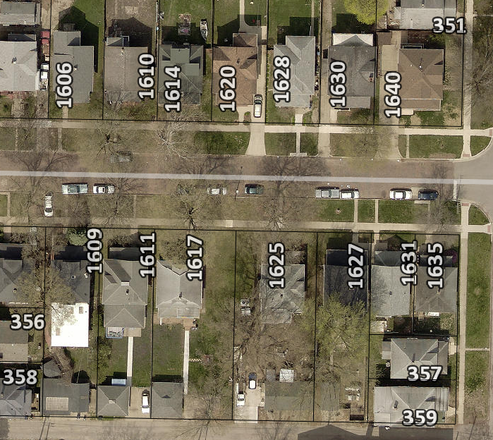
Project Description
Painting the exterior of the home, including the trim. Includes prep work.
Bid 1: Jim Heskje Painting Specialist—$16,750.00
Bid 2: Jim Hale Painting—$22,000.40

Slide 30
1627 Park Ave SE

Slide 31
Recommendation
Staff recommends approval of funding for the project:
Project is eligible for the program; and
Consistent with District Guidelines; and
Not removing architectural detailing; and
No impact on defining features; and
Keeps the structure in use and good repair.

Slide 32
Historic Preservation Commission
Staff Liaison:
Adam Lindenlaub
Comm. Dev. Planner
a.lindenlaub@cedar-rapids.org
319.286.5064
William Micheel
Comm. Dev. Assistant Director
w.micheel@cedar-rapids.org
319.286.5045

