Slide 1
Historic Preservation Commission
May 10, 2018

Slide 2
221 15th St SE
Certificate of Appropriateness

Slide 3
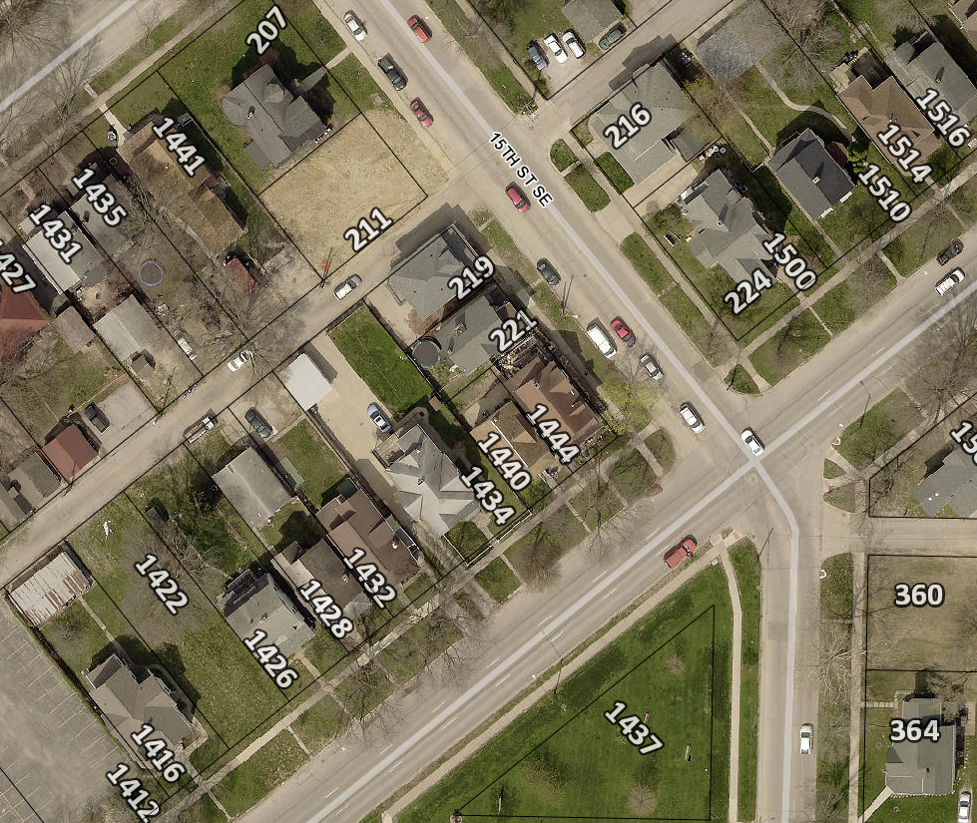
Project Description
Replace decking, railing and steps on existing porch.
Constructed in 1900
Contributing structure to the 2nd and 3rd Ave District.

Slide 4
221 15th St SE
Photograph from 1995

Slide 5
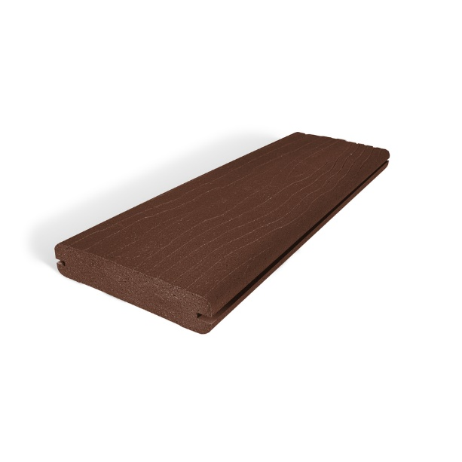
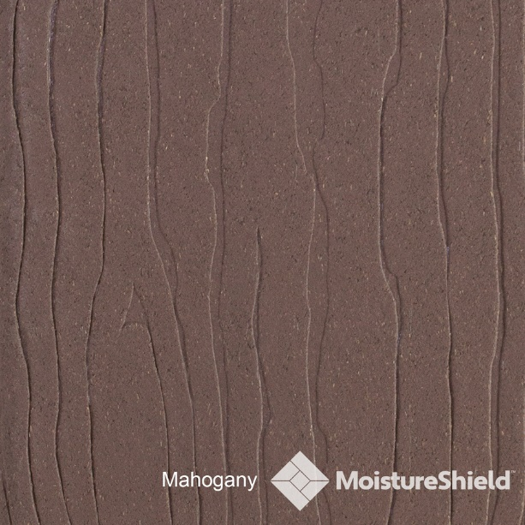
Materials
Composite decking
Wood plastic composite covered with a PVC skin.

Slide 6
Historic District Guidelines - Porches and Other Entrances
Recommended:
Opening an enclosed porch
Repairing the existing porch or balcony
Replacing wood elements (wood elements should be painted)
Replacing masonry elements with masonry elements
Rebuilding a porch with original materials
Screening
Painted, not treated wood
Not Recommended:
Enclosing porches visible from the street
Modern straight-edged railings
Columns made of modern materials (fiberglass for an example)
Plywood panel flooring on entrances facing the street
Carpeted flooring on entrances facing the street
Concrete steps that are visible from the street
Unpainted treated lumber elements (recommended for hidden supports)

Slide 7
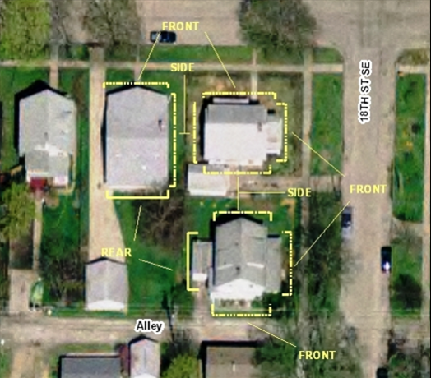
Guideline Prioritization
Those features that face the street or face the alley where it intersects the street. Buildings on corner lots, lots which are located at the intersection of two streets, or at the intersection of a street and an alley, are considered to have two street faces.
Features on sides of buildings that are visible from the street but don’t directly face the street.
Other exterior features not in direct view from the street such as at the rear of buildings.

Slide 8
Criteria for Decision
If any defining features of the building or structure as indicated, but not limited to those included on the Site Inventory Form(s) are proposed to be modified as a result of the proposal indicated on the application for Certificate.
If the proposal is consistent with the Guidelines for Cedar Rapids Historic Districts and/or the most recent edition of the Secretary of Interior's Standards for Rehabilitating Historic Buildings.
If the proposal mitigates adverse effects on the aesthetic, historic, or architectural significance of either the building or structure or of the local historic district or local historic landmark.

Slide 9
Recommendation
Staff recommends approval of project
Contributes to the livability and functionality of the home;
Not the original front porch to the home;
Maintenance-friendly building materials

Slide 10
Actions
Approve as submitted; or
Approve with modifications agreeable to the applicant; or
Deny the application; or
Request additional information.

Slide 12
347 18th St SE
Certificate of Appropriateness

Slide 13
Project Description
Constructed in 1915
Replacing a total of 17 windows
Replacing 2 side doors
Relocating a side door to rear
Addition of 1 garage door.
Contributing structure to the Redmond Grande Historic District

Slide 14
347 18th St SE

Slide 15
347 18th St SE

Slide 16
347 18th St SE
Relocating door
Replacing door

Slide 17
347 18th St SE
Approximate location
of new door

Slide 18
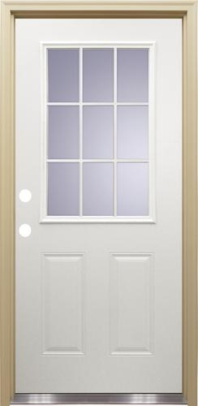
Materials
Jeldwen wood windows
Premium Jeldwen vinyl windows
Mastercraft steel exterior doors

Slide 19
Windows Guidelines
Recommended:
Retain and repair historic window sashes and frames
Replace windows with the home’s original window material (e.g. wood for wood)
Replacement windows should match the originals as closely as possible
Repair or install new storm windows
Vinyl or aluminum products are allowed only at the rear of a house
Not Recommended:
Windows constructed of modern building materials, such as vinyl or aluminum on the front and side of homes
Decreasing the size of the window opening

Slide 20
Door Guidelines
Recommended:
Repairing the original wood door
Replacing doors visible from the street with wood doors
Storm or screen doors
Retaining the same door size
Retaining historic trim around doors
Not Recommended:
Replacing doors visible from the street with doors made of modern materials
Unusual shaped glass panes (such as star bursts)
Increasing or decreasing the original door size.

Slide 21
Guideline Prioritization
Those features that face the street or face the alley where it intersects the street. Buildings on corner lots, lots which are located at the intersection of two streets, or at the intersection of a street and an alley, are considered to have two street faces.
Features on sides of buildings that are visible from the street but don’t directly face the street.
Other exterior features not in direct view from the street such as at the rear of buildings.

Slide 22
Criteria for Decision
If any defining features of the building or structure as indicated, but not limited to those included on the Site Inventory Form(s) are proposed to be modified as a result of the proposal indicated on the application for Certificate.
If the proposal is consistent with the Guidelines for Cedar Rapids Historic Districts and/or the most recent edition of the Secretary of Interior's Standards for Rehabilitating Historic Buildings.
If the proposal mitigates adverse effects on the aesthetic, historic, or architectural significance of either the building or structure or of the local historic district or local historic landmark.

Slide 23
Recommendation
Staff recommends approval of the project
Project mitigates its effects by using wood windows on the front façade.
Modern materials on sides that afford the most flexibility

Slide 24
Actions
Approve as submitted; or
Approve with modifications agreeable to the applicant; or
Deny the application; or
Request additional information.

Slide 26
2000 4th Ave SE
Demolition Review

Slide 27
2000 4th Ave SE
Accessory structure built in 1914
Within area recommended for intensive survey
Cedar Rapids Citywide Historic and Architectural Reconnaissance Survey
Immediate release

Slide 28
2000 4th Ave SE

Slide 29
2000 4th Ave SE
Accessory structure in below normal condition
Area is recommended for intensive survey
No current survey property information

Slide 30
1. Determination of Historic Significance
2a. Not Historically Significant
2b. Historically Significant
Release Property
60-day hold if HPC wishes to explore options (e.g. photo doc) with property owner
Release property if HPC does not wish to explore options

Slide 31
18.02(T) Cedar Rapids Municipal Code – Historic Significance:
1. Associated with events that have made a significant contribution to the broad patterns of our history; or
2. Associated with the lives of significant persons in our past; or
3. Embodies the distinctive characteristics of a type, period, or method of construction, or represents the work of a master, or possesses high artistic values, or represents a significant and distinguishable entity whose components may lack individual distinction; or
4. Yielded, or may be likely to yield, information important in history or prehistory.

Slide 32
386 25th St SE
Demolition Review

Slide 33
386 25th St SE
Accessory structure built in 1920
Within area recommended for intensive survey
Cedar Rapids Citywide Historic and Architectural Reconnaissance Survey
Immediate release

Slide 34
386 25th St SE

Slide 35
386 25th St SE
Accessory structure in below normal condition
Area is recommended for intensive survey
No current survey information

Slide 36
1. Determination of Historic Significance
2a. Not Historically Significant
2b. Historically Significant
Release Property
60-day hold if HPC wishes to explore options (e.g. photo doc) with property owner
Release property if HPC does not wish to explore options

Slide 37
18.02(T) Cedar Rapids Municipal Code – Historic Significance:
1. Associated with events that have made a significant contribution to the broad patterns of our history; or
2. Associated with the lives of significant persons in our past; or
3. Embodies the distinctive characteristics of a type, period, or method of construction, or represents the work of a master, or possesses high artistic values, or represents a significant and distinguishable entity whose components may lack individual distinction; or
4. Yielded, or may be likely to yield, information important in history or prehistory.

Slide 38
1404 1st Ave SE
Demolition Review

Slide 39
1404 1st Ave SE
Retail structure built in 1954
No current survey information
Immediate release

Slide 40
1404 1st Ave SE

Slide 41
1404 1st Ave SE

Slide 42
1404 1st Ave SE
No historic survey available
Poor candidate for land-marking
No architectural significance

Slide 43
1. Determination of Historic Significance
2a. Not Historically Significant
2b. Historically Significant
Release Property
60-day hold if HPC wishes to explore options (e.g. photo doc) with property owner
Release property if HPC does not wish to explore options

Slide 44
18.02(T) Cedar Rapids Municipal Code – Historic Significance:
1. Associated with events that have made a significant contribution to the broad patterns of our history; or
2. Associated with the lives of significant persons in our past; or
3. Embodies the distinctive characteristics of a type, period, or method of construction, or represents the work of a master, or possesses high artistic values, or represents a significant and distinguishable entity whose components may lack individual distinction; or
4. Yielded, or may be likely to yield, information important in history or prehistory.

Slide 45
1408 1st Ave SE
Demolition Review

Slide 46
1408 1st Ave SE
Residential structure built in 1905
Listed as individually eligible for the National Register of Historic Places
Consider placing a 60-day hold

Slide 47
1408 1st Ave SE

Slide 48
1408 1st Ave SE

Slide 49
1408 1st Ave SE
Identified as an eligible resource for the National Register of Historic Places
Site visit indicated it was in normal condition
Exploring a possible option for moving the building

Slide 50
1. Determination of Historic Significance
2a. Not Historically Significant
2b. Historically Significant
Release Property
60-day hold if HPC wishes to explore options (e.g. photo doc) with property owner
Release property if HPC does not wish to explore options

Slide 51
18.02(T) Cedar Rapids Municipal Code – Historic Significance:
1. Associated with events that have made a significant contribution to the broad patterns of our history; or
2. Associated with the lives of significant persons in our past; or
3. Embodies the distinctive characteristics of a type, period, or method of construction, or represents the work of a master, or possesses high artistic values, or represents a significant and distinguishable entity whose components may lack individual distinction; or
4. Yielded, or may be likely to yield, information important in history or prehistory.

Slide 52
110 14th St NE
Demolition Review

Slide 53
110 14th St NE
Office building built in 1962
No available survey information
Immediate release

Slide 54
110 14th St NE

Slide 55
110 14th St NE

Slide 56
110 14th St NE
No current survey information
Poor candidate for land-marking
No architectural significance

Slide 57
1. Determination of Historic Significance
2a. Not Historically Significant
2b. Historically Significant
Release Property
60-day hold if HPC wishes to explore options (e.g. photo doc) with property owner
Release property if HPC does not wish to explore options

Slide 58
18.02(T) Cedar Rapids Municipal Code – Historic Significance:
1. Associated with events that have made a significant contribution to the broad patterns of our history; or
2. Associated with the lives of significant persons in our past; or
3. Embodies the distinctive characteristics of a type, period, or method of construction, or represents the work of a master, or possesses high artistic values, or represents a significant and distinguishable entity whose components may lack individual distinction; or
4. Yielded, or may be likely to yield, information important in history or prehistory.

Slide 59
#5 Turner Alley
810 2nd Ave SE
Built in 1895
Grant Wood Studio
Public interest for historic marker
American Gothic was painted in this studio
Recommendation to add to the historic marker program

Slide 60
#5 Turner Alley

Slide 61
American Trust Building
101 2nd St SE
Built in 1914
Contributing to the NRHP downtown district
Public interest for historic marker
Recommendation to add to the historic marker program

Slide 62
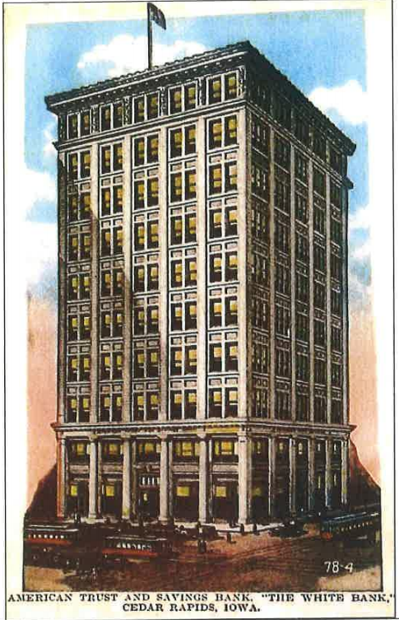
American Trust Building

Slide 63
Historic Preservation Commission
Staff Liaison:
Iván Gonzalez
Planner
i.gonzalez@cedar-rapids.org
319.286.5428
William Micheel
Comm. Dev. Assistant Director
w.micheel@cedar-rapids.org
319.286.5045

